Slide 1
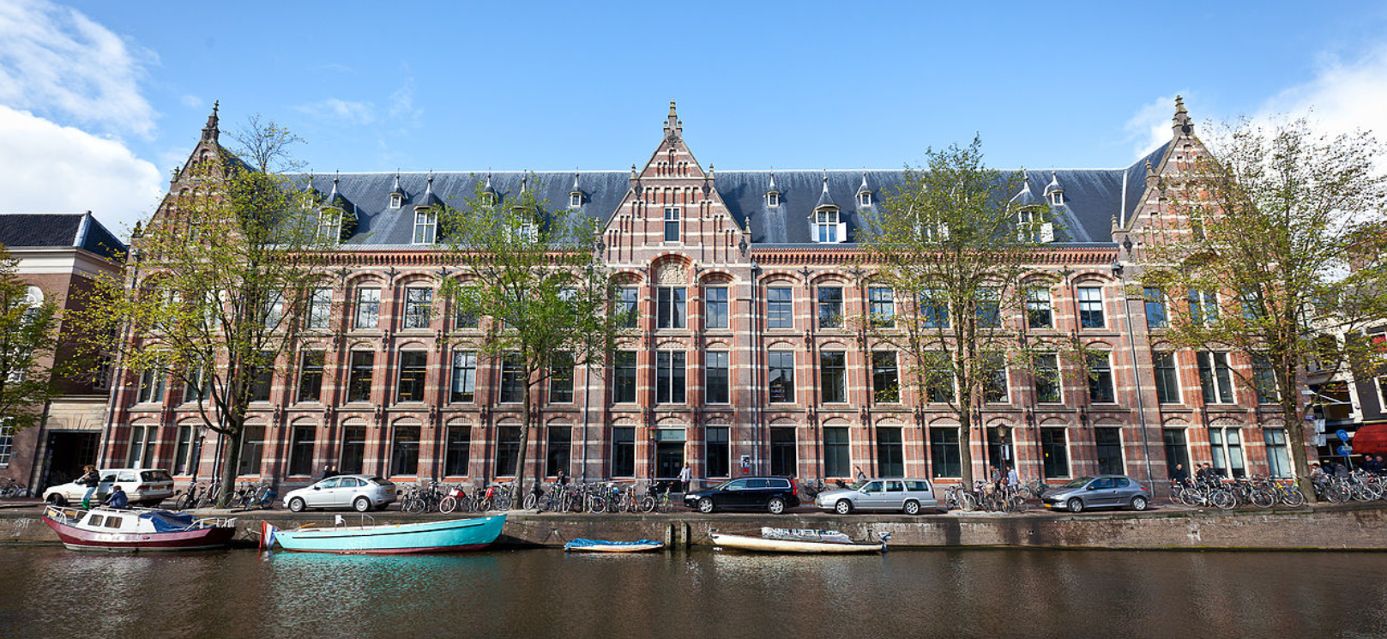
Quantum Cognition, Concepts, and Compositional Semantics
Reinhard Blutner, University of Amsterdam

Slide 2
Introduction: Historical Background
Bohrs Atomic Model
The Idea of Complementarity
Bounded Rationality

Slide 3
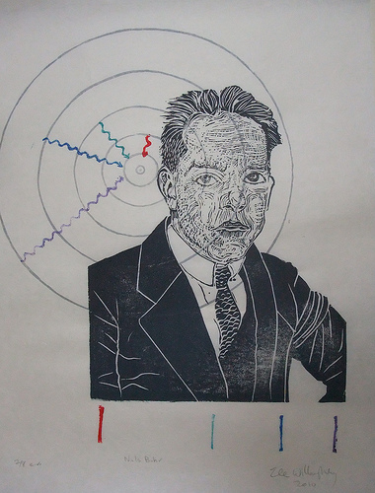
Bohr´s (1913) Atomic Model
Almost exact results for systems where two charged points orbit each other
(→ spectrum of hydrogen)
The model cannot explain the spectra of larger atoms, the fine structure of spectra, the Zeeman effect.
Conceptual problems: conservation laws (energy, momentum) do not hold.
Notes:
Ferris Wheel Illusion. If you do not see it, you should see a doctor.

Slide 4
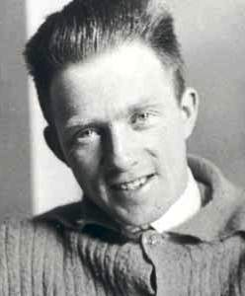
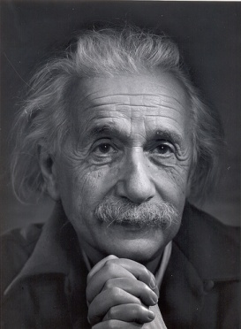
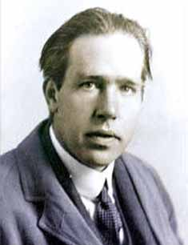
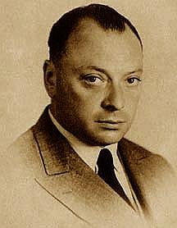
Quantum Mechanics
Heisenberg
Einstein
Bohr
Pauli
Historically, QM is the result of a successful resolutions of the empirical and conceptual problems in the development of atomic physics (≈1900-1925)
The founders of QM have borrowed some crucial ideas from psychology
Notes:
Ferris Wheel Illusion. If you do not see it, you should see a doctor.

Slide 5
Complementarity
William James was the first who introduced the idea of complementarity into psychology
“It must be admitted, therefore, that in certain persons, at least, the total possible consciousness may be split into parts which coexist but mutually ignore each other, and share the objects of knowledge between them. More remarkable still, they are complementary” (James, the principles of psychology 1890, p. 206)
Nils Bohr introduced the idea into physics (Complementarity of momentum and place) and proposed to apply it beyond physics to human knowledge.
5
Notes:
5

Slide 6
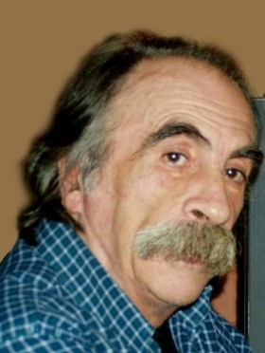
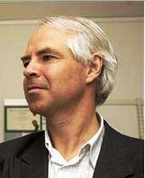
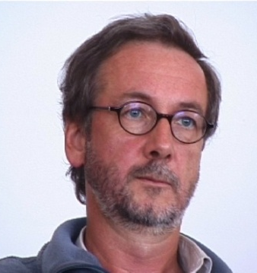
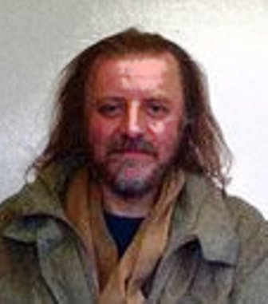
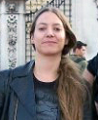
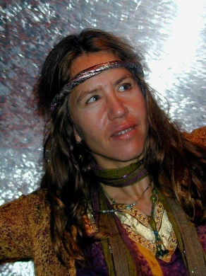

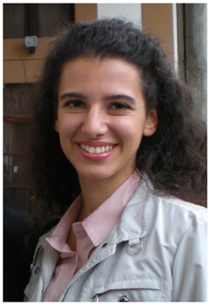
Quantum Cogniton
Conte
1989
Khrennikov
1998
Atmanspacher
1994
Heisenberg
Einstein
Bohr
Pauli
Aerts
1994
Historically, Quantum Cognition is the result of an successful resolutions of the empirical and conceptual problems in the development of cognitive psychology
Basically, it resolves several puzzles in the context of bounded rationality, vagueness, typicality, …
6
Sonja Smet
Liane Gabora
Irena Basijeva
Maria Mannone
Notes:
Ferris Wheel Illusion. If you do not see it, you should see a doctor.

Slide 7
Part 1: Structure of Concepts
Geometric models in Psychology
Vagueness and Typicality
Judgement of Membership (Hampton 1988)
Fuzziness and quantum probabilities

Slide 8
Geometric models in Cognitive Psychology I
Basic claim: An understanding of problem solving, categorization, memory retrieval, inductive reasoning, and other cognitive processes requires that we understand how humans assess similarity.
W. S. Torgerson (1965): Multidimensional scaling of similarity. Psychometrika 30: 379–393.
8
Notes:
8

Slide 9
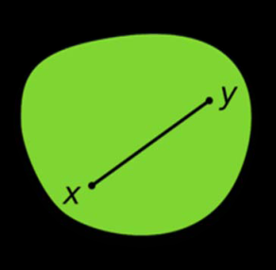
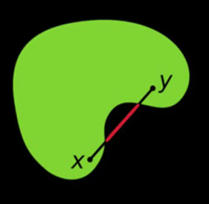
Geometric models in Cognitice Psychology II
A. Tversky (1977): Features of similarity. Psychological Review 84: 327–352.
P. Gärdenfors: The Geometry of Thought (2000)
Concepts as convex spaces
D. Widdows: Geometry and Meaning (2004)
Distributional semantics
9
Notes:
9

Slide 10
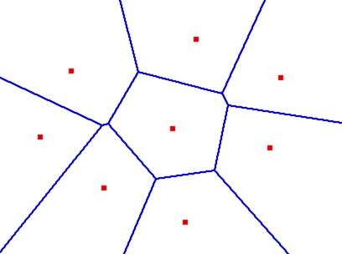
Voronoi Tessellation
If the closeness to a prototyp determines class boundaries, then we get a partition of the conceptual space into convex subspaces
10

Slide 11
Natural concepts do not form Boolean algebras
P. Gärdenfors: The Geometry of Thought (2000) Concepts as convex spaces
The intersection of convex sets is convex again, but union and complement are not.
Hans Primas: Convex sets form orthomodular lattices.
Orthomodularity: If x ≤ y then y = x ∨ (x⊥∧y)
11
Notes:
11
11
11

Slide 12
Possible worlds vs. vectors
Possible worlds: Isolated entities which are used for modeling propositions (sets of possible worlds)
Vector states: abstract objects which form vector spaces.
  The addition of two vectors is an operation which describes the super-position of possibly conflicting states.
  The scalar product is an operation which describes the similarity of two states.
  Projections are operators that map vector spaces onto certain subspaces.
  Probabilities are generated by states s as the squared lengths of projections.
s
A
u
12
Notes:
12

Slide 13
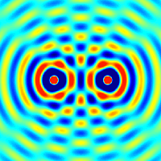
Superposition
Superposing colors
Superposing pictures
Superposing meanings
13
Notes:
13
13

Slide 14

Superposing colors
x
14
Notes:
14
14

Slide 15
x
15
Notes:
15
15

Slide 16
x
16
Notes:
16
16

Slide 17
x
17
Notes:
17
17

Slide 18
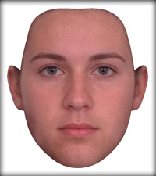
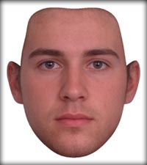
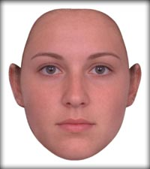
Superposition of faces
x
18
Notes:
18

Slide 19
Structure of the task
Left: superposition of female human faces
Right: superposition of male human faces
Middle: superposition of male and female faces
19
Notes:
19

Slide 20
Superposition of Concepts
Many puzzles of bounded rationality can be treated as superposition effects (exploiting phase parameters)
  Hawaian vacation
  Conjunction puzzle
  Ellsberg puzzle, order effects,…
  (some but not all can be resolved by using prospect theory)
Hampton: membership values for concepts
  a library is a dwelling vs. a library is a building and dwelling.

Slide 21
Vagueness and typicality
A concept is vague if it does not have precise, sharp boundaries and does not describe a well-defined set.
Vagueness is the inevitable result of a knowledge system that stores the centers rather than the boundaries of conceptual categories
Vagueness is different from typicality (centrality):
  both robins and penguins are clearly birds, but robins are more typical than penguins as birds
  7 is a more typical prime number than 23
21
Notes:
21
21
21

Slide 22
Why classical probabilities do not work
Monotonicity
X⊆Y ⇒ P(X) ≤ P(Y)
Additivity
P(X)+P(Y) = P(X∩Y)+P(X∪Y)
Y
X
X ∪ Y
X∩Y Y
X
22
Notes:
22

Slide 23
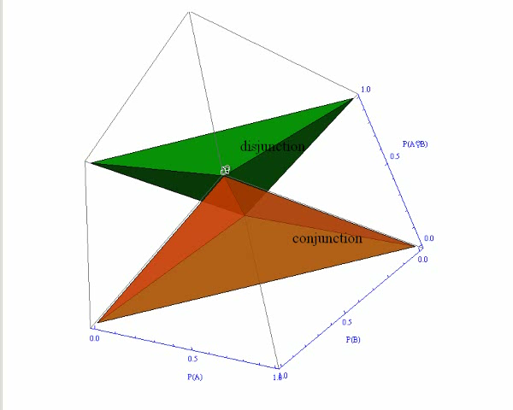
Pitkowsky diamond
Disjunction
P(A∪B) ≥ max(P(A),P(B))
P(A)+P(B)−P(A∪B) ≤ 1
Conjunction
P(A∩B) ≤ min(P(A),P(B))
P(A)+P(B)−P(A∩B) ≥ 1
23
Notes:
23

Slide 24
Hampton 1988: judgement of membership
A and B
overextension
A or B
underextension, *additive
A | B
Furniture Food Weapon Building Machine Bird | Household appliances Plant Tool Dwelling Vehicle Pet
A | B
Home furnishing Hobbies Spices Instruments Pets Sportswear Fruits Household appliances | Furniture Games Herbs Tools Farmyard animals Sports equipment Vegetables Kitchen utensils
Notes:
24

Slide 25
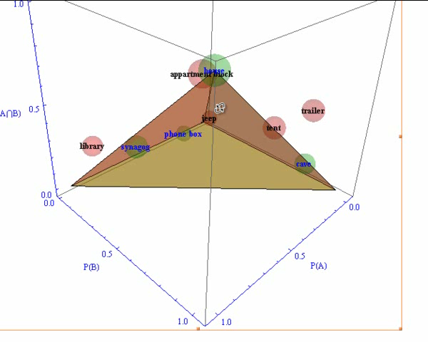
Conjunction (building & dwelling)
Classical: cave, house, synagogue, phone box.
Non-classical: tent, library, apartment block, jeep, trailer.
Example ‘overextension’
μ_{library}(building) = .95
μ_{library}(dwelling) = .17
μ_{library}(b_& d_) = .31
Cf. Aerts: J.MathPsych 53, 314-348 (2009)
25
Notes:
25

Slide 26
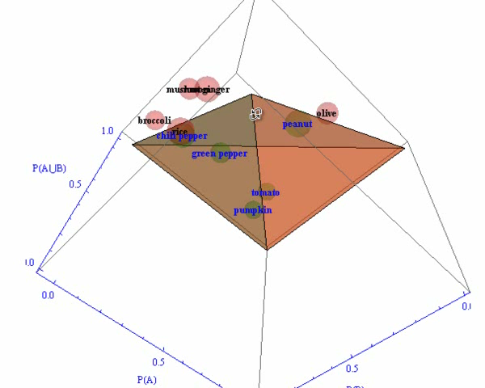
Disjunction (fruit or vegetable)
Classical: green pepper, chili pepper, peanut, tomato, pumpkin.
Non-classical: olive, rice, root ginger mushroom, broccoli,
Example ‘additivity’
μ_{olive}(fruit) = .5
μ_{olive}(vegetable) = .1
μ_{olive}(f_∪ v_) = .8
Notes:
26

Slide 27
Part 2: Compositional Semantics
Natural Language Interpretation is Direct
Context Sensitivity & Adjectival Modification
Borderline Contradictions

Slide 28

Direct Interpretation (Millikan)
Perception: direct interpret-tion of sensory input
  automatic, unreflective, instinctive
  normally, it is not based on some kind of reasoning.
NL Comprehension
  Syntax & Semantics:
  automatic, unreflective, etc.
  Pragmatic interpretation: indirect, reflective, normally based on reasoning (inferentialism)
Notes:
Ferris Wheel Illusion. If you do not see it, you should see a doctor.

Slide 29
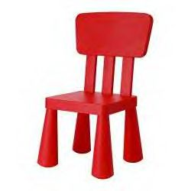
Direct Perception through Language
We directly perceive a red chair here.
We automatically derive that without
deliberation about the reliability of the
sources (reflected light).
DPL: Natural language interpretation is basically as direct as perception
  Derivation of utterance meaning does not proceed by conscious inference
  The content of the heard utterances integrates automatically our „belief boxes“
29

Slide 30
Descartes vs. Spinoza
Can people comprehend assertions without believing them?
  Descartes suggested that people can and should
  Spinoza suggested that people should but cannot.
Burge (1993): We may invoke (conscious) justification for not believing the content of some utterance. The default position, however, is to accept such contents as true.
Evolutionary arguments (Axelrod, Millikan, Burge)
Empirical evidence (Hasher et al. 1977; Gilbert 1993)

Slide 31
First Resumé
The assumption that NL interpretation is as direct as perception (DPL-thesis) has important consequences for constructing psychologically adequate models of interpretation.
I propose to take DPL as a serious challenge for computational models of NL interpretation
DPL − properly generalized − asks for a default mode of NL interpretation which is fully compositional and runs automatically.

Slide 32
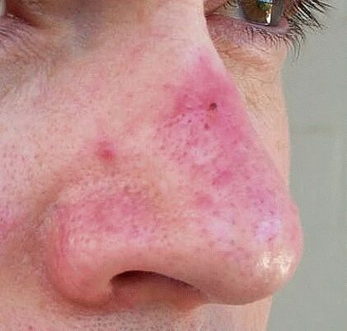

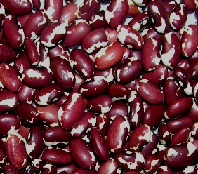
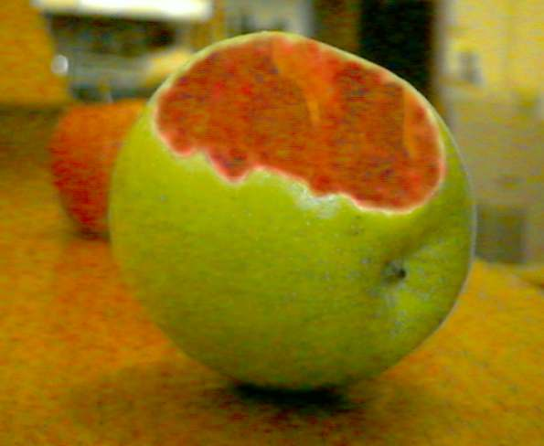
Context sensitivity: the effect of contrast classes
A collie is a dog, but a tall collie is not a tall dog
“tall” is subsective but not intersective
Red nose
red flag
red beans
This is a green apple (but
inside it is red)
  My preferred example for
  truth-conditional pragmatics
  François Recanati:
  Literal Meanings 2004;
  Truth Conditional Pragm. 2006)
32

Slide 33
How to calculate truth conditions?
The mechanism of adnominal functors requires idiosyncratic lexical entries for fixing the interpretations of complex expressions.
E.g., Quasi-deictic elements
tall boy → λx [tall*(x,N) & boy(x)]
  * tall(x, N) ⇔ size(x) > N (Sag, Bartsch, Bosch)
Alternative suggestions from Cognitive Linguistics
  Blending theory** (Fouconnier & Turner)
  Modulation (Recanati)
What is the computational mechanism? A lovely notation does not yet provide a real mechanism.
** In blending theory, the part of a concept for which a given modification is relevant is
referred to as an ‘active zone’, first discussed as such in Langacker (1991). In the case
of an apple, the color is only relevant for the skin of the apple, which is its active zone.
33
Notes:
33

Slide 34
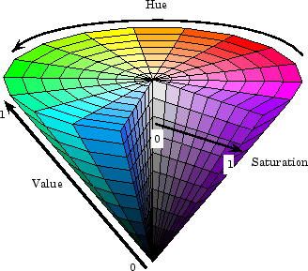
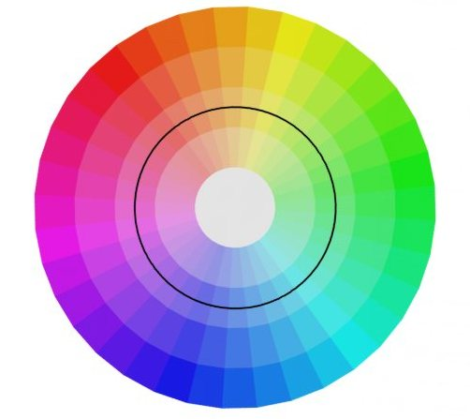
Concept combination á la
Peter Gärdenfors
What is the color of a red nose
(red flag, red tomato)?
skin colors
What is the computational mechanism of combination?
34
Notes:
34

Slide 35
Typicality and the conjunction effect
x=guppy is a poorish example of a fish (B), and a poorish example of a pet (A*), but it's quite a good example of a pet fish (A*&B)
  c_{x}(A*&B) – c_{x}(B) > 0
In case of "incompatible conjunctions" such as pet fish or striped apple the conjunction effect is greater than in "compatible conjunctions“ (red apple).
  c_{x}(A* & B) – c_{x}(B ) > c_{x}(A & B) – c_{x}(B)
  (if A invites B but A* does not invite B)
Do not treat the phenomenon as superposition (sum) but as a kind of multiplication (tensor product)
35

Slide 36
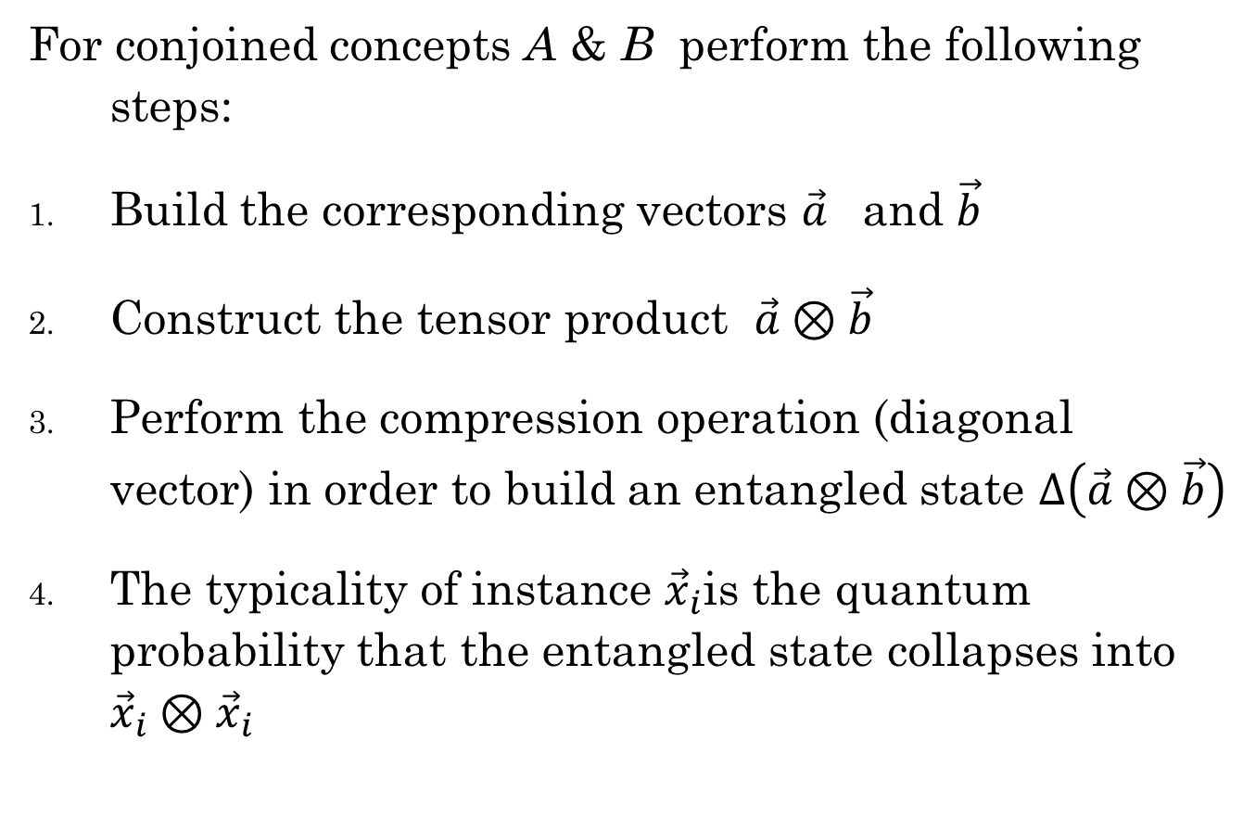
Typicality of Conjoined Concepts
For conjoined concepts A & B perform the following steps:
Build the corresponding vectors $\vec{a}$ and $\vec{b}$
Construct the tensor product $\vec{a}⊗\vec{b}$
Perform the compression operation (diagonal vector) in order to build an entangled state $Δ\left(\vec{a}⊗\vec{b}\right)$
The typicality of instance ${\vec{x}}_{i}$is the quantum probability that the entangled state collapses into
${\vec{x}}_{i}⊗{\vec{x}}_{i}$
36

Slide 37
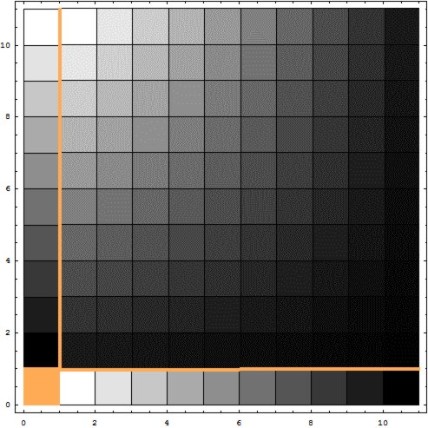
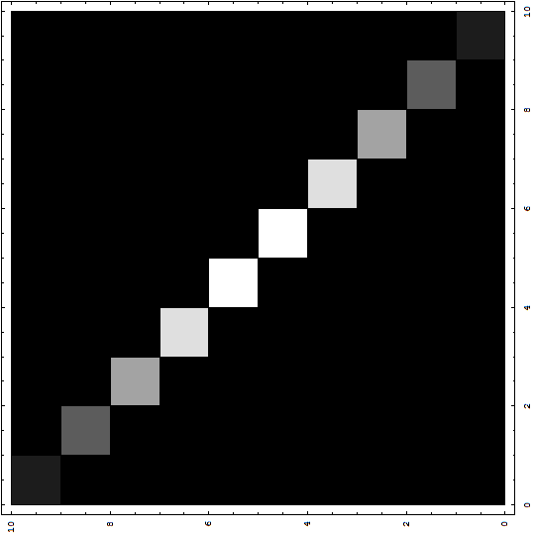


Compression goes quantum
Modification
Δ [ ] = (diagonal vector)
$$\vec{a}∘\vec{b}=Δ(\vec{a}⊗\vec{b})$$
37
Notes:
37
37
Concept A: Apple
Concept B: stripped
White = high probability

Slide 38
Examples 1: striped apple
striped
apple
striped apple
38
Reinhard Blutner

Slide 39
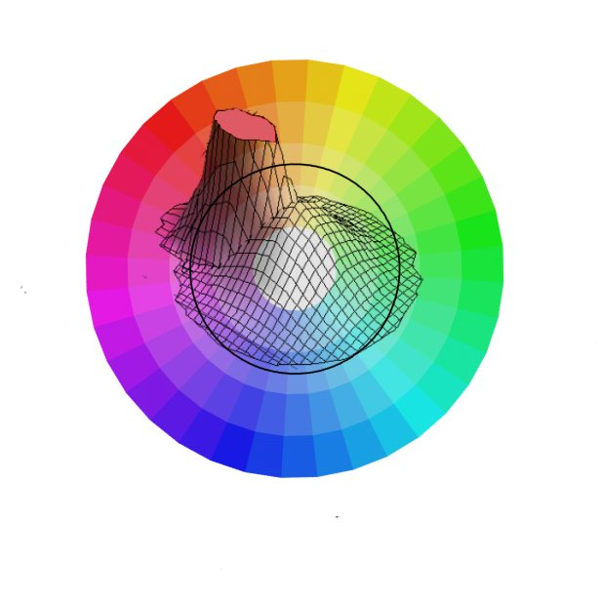
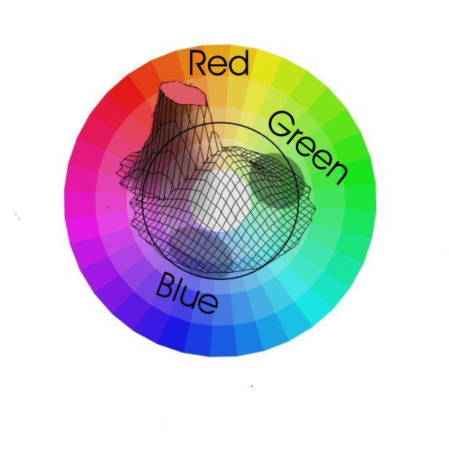
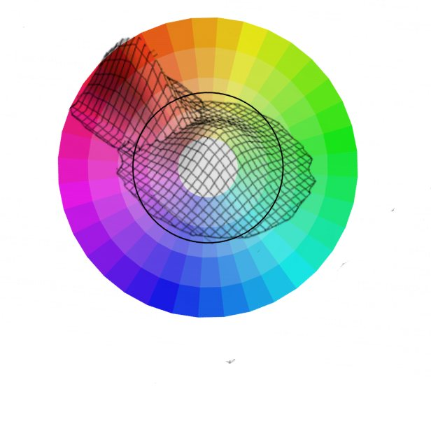
Examples 2: red nose
Color Distribution Noses
General Distribution Red
Conjoined Concept
Red Nose
39

Slide 40
Examples 3: tall boy
tall•boy
boy
tall
40
Notes:
40
40

Slide 41

Examples 4a: red apple (color of peel)
$$KLI=\int_{−∞}^{+∞}{μ(x)\log{(}\frac{μ(x)}{μ_{0}(x)}})dx$$
Relevance
red•apple
red
apple
41
Kullback-Leibler information = 0.25
Notes:
41
41

Slide 42
Examples 4b: red apple (color of pulp)
red•apple
apple
red
Kullback-Leibler information = 0.06
42
Notes:
42
42

Slide 43
Borderline Contradictions
Pictures with 5 persons of different size are presented.
(Order of persons randomized)
Subjects have to judge forms with 4 sentences as True/False/Can’t Tell. (Order of questions randomized)
#3 is tall True ❏ False ❏ Can’t Tell ❏
#3 is not tall True ❏ False ❏ Can’t Tell ❏
#3 is tall and not tall True ❏ False ❏ Can’t Tell ❏
#3 is neither tall nor not tall True ❏ False ❏ Can’t Tell ❏
43

Slide 44
Data of Alxatib & Pelletier 2011
Rejecting
‘X is neither tall nor not tall’/
‘X is tall and not tall’
Accepting
‘X is neither tall nor not tall’/
‘X is tall and not tall’
Blutner, Pothos, and Bruza: A Quantum Probability Perspective on Borderline Vagueness. Topics in Cognitive Sciences 2013 Vol. 5 Pages 711-736
44
Notes:
44

Slide 45
Part 3: Distributional Semantics
Meanings are in the Mind (Cognitive S.)
Meanings are in the Text (Distributional S.)
Compositionality
45

Slide 46
Meaning & Distribution
“The meaning of a words is its use in language”
— Ludwig Wittgenstein
“You shall know a word by the company it keeps!”
— J. R. Firth (1957)
“Distributional hypothesis: Words that occur in the same contexts tend to have similar meanings”
—Zellig Harris 1954
46

Slide 47
What is the meaning of “bardiwac”?
He handed her her glass of bardiwac.
Beef dishes are made to complement the bardiwacs.
Nigel staggered to his feet, face flushed from too much bardiwac.
Malbec, one of the lesser-known bardiwac grapes, responds well to Australia’s sunshine.
I dined off bread and cheese and this excellent bardiwac.
The drinks were delicious: blood-red bardiwac as well as light, sweet Rhenish.
⇒ bardiwac is a heavy red alcoholic beverage made from grapes
47

Slide 48
Term-document matrix
Consider the frequencies of words in certain documents. From this information we can construct a vector for each word reflecting the corresponding frequencies (possibly applying singular value decomposition for reducing dimensions)
 | Document 1 | Document 2 | Document 3
bank | 0 | 0 | 1
bass | 0.447 | 0.894 | 0
cream | 1 | 0 | 0
guitar | 1 | 0 | 0
fisherman | 0 | 1 | 0
money | 0 | 0.447 | 0.894
 | Document 1 | Document 2 | Document 3
bank | 0 | 0 | 4
bass | 2 | 4 | 0
cream | 2 | 0 | 0
guitar | 1 | 0 | 0
fisherman | 0 | 3 | 0
money | 0 | 1 | 2
48
Document 1 is about music instruments, document 2
about fishermen, and document 3 about financial institutions.

Slide 49
Similarity Matrix (scalar product/cos φ)
 | bank | bass | cream | guitar | fisherman | money
bank |  | 0 | 0 | 0 | 0 | 0.894
bass | 0 |  | 0.447 | 0.447 | 0.894 | 0.400
cream | 0 | 0.447 |  | 1 | 0 | 0
guitar | 0 | 0.447 | 1 |  | 0 | 0
fisherman | 0 | 0.894 | 0 | 0 |  | 0.447
money | 0.894 | 0.400 | 0 | 0 | 0.447
49

Slide 50
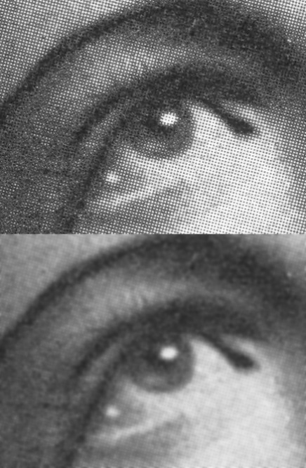
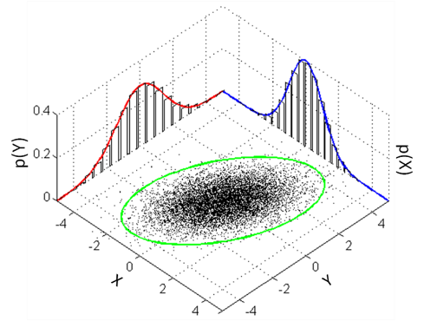
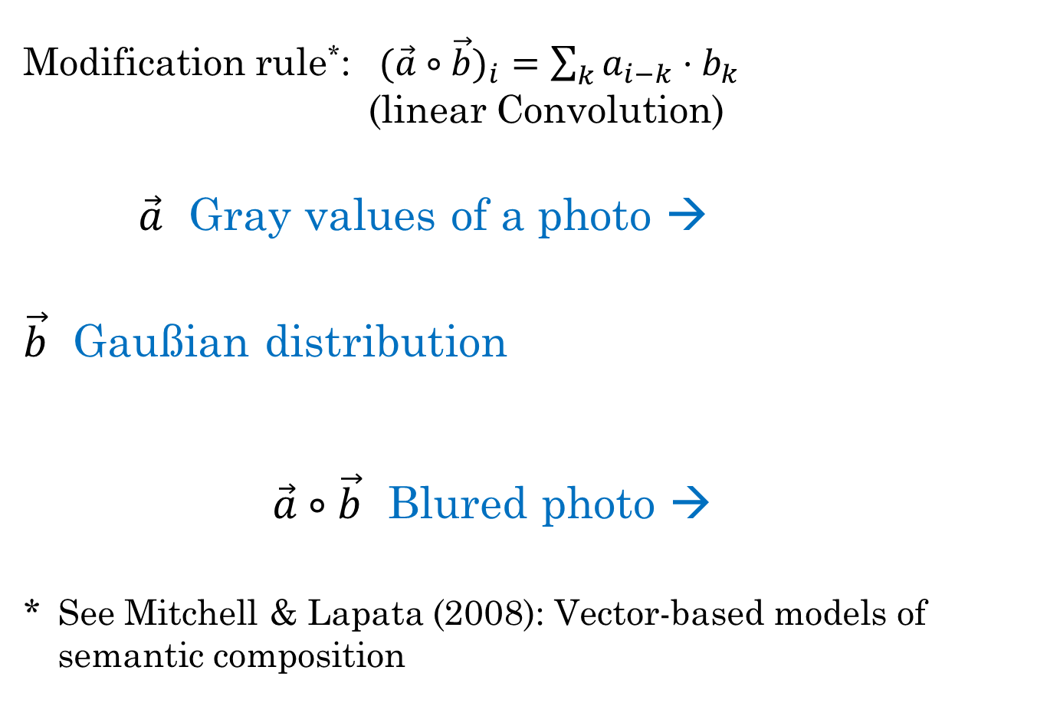
Modification Rule in
Distributional Semantics
Modification rule*: $(\vec{a}∘\vec{b})_{i}=\sum_{k}{a_{i−k}⋅b_{k}}$ (linear Convolution)
$\vec{a}$ Gray values of a photo →
$\vec{b}$ Gaußian distribution
    $\vec{a}∘\vec{b}$ Blured photo →
* See Mitchell & Lapata (2008): Vector-based models of semantic composition
Notes:
50
50
50

Slide 51
Conclusions
Quantum models are a useful extension of geometric models of meaning
Handling uncertainty, ignorance, vagueness, typicality
Integrate cognitive models, neuronal models and distributional models of meaning
Advantages
  Models are explicit and constrained
  Well-defined mathematics (linear algebra)
Open issues:
  How restrictive is the theory?
  Sometimes assuming too many free parameters?

Slide 52
Appendix

Slide 53
Why fuzzy sets do not work
Chose instance x such that x
m_{CIRCLE}(x) = m_{SQUARE}(x)
Compositionality:
m_{CIRCLE}(x)=m_{SQUARE}(x) ⇒ m_{ROUND CIRCLE}(x)=m_{ROUND SQUARE}(x)
→ Compositionality of membership m is violated
Monotonicity:
m_{ROUND SQUARE} (x) ≤ m_{SQUARE} (x)
→ Monotonicity of m is violated (conjunction puzzle)
53
Notes:
53
53
53

Slide 54
Membership & Typicality
The vector a represents the prototype of the concept A
The yellow plance repre-sents the concept as a whole
The squared length of the projection of x onto the vector a is the typicality of x
The squared length of the projection of x onto A is the degree of membership that x is a member of A
c_{x}(A) ≤ m_{x}(A)
x
a
A = 1
54
Notes:
54

Slide 55
Natural classification? (B. Partee)
intersective
blond,
rectangular,
French
subsective
modal
tall, good,
typical,
recent
modal
privative
alleged,
potential,
arguable
blond,
rectangular,
French
alleged,
potential,
arguable
spurious,
imaginary,
fake.
spurious,
imaginary,
fake.
55
Notes:
55
55

Slide 56
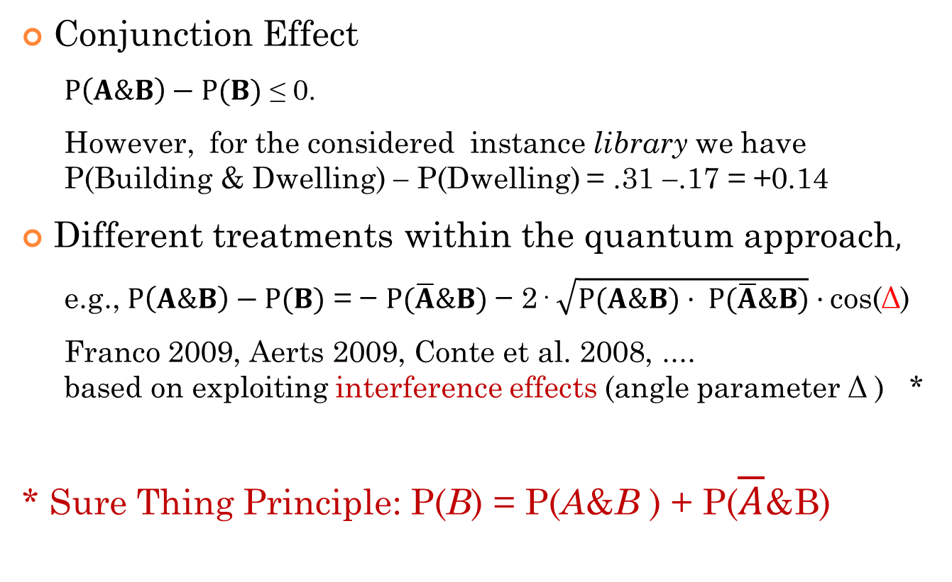
Conjunction Puzzle Resolved by Interference Effects
Conjunction Effect
  $P\left(A\&B\right)−P(B)$ ≤ 0.
  However, for the considered instance library we have
  P(Building & Dwelling) − P(Dwelling) = .31 −.17 = +0.14
Different treatments within the quantum approach$,$
  e.g., $P\left(A\&B\right)−P(B)$ = − $P(\overline{A}\&B)$ − 2· $\sqrt{P(A\&B)· P(\overline{A}\&B)}·$cos(Δ)
  Franco 2009, Aerts 2009, Conte et al. 2008, ....
  based on exploiting interference effects (angle parameter Δ ) *
* Sure Thing Principle: P(B) = P(A&B ) + P($\overline{A}$&B)

Slide 57
Abstract
Quantum Cognition, Concepts, and Compositional Semantics
Reinhard Blutner
Geometric models of concepts and meaning have become very popular within the last couple of decades (Suppes, Krantz, Luce, & Tversky, 1989; Torgerson, 1965; Tversky, 1977; Widdows, 2004). Quantum cognition can be seen as further developing this approach, both empirically and theoretically. After giving a brief overview of the history and development of quantum cognition in the last two decades, a will consider three aspects in more detail using vivid geometric ideas.
In the first part, I will consider in detail the structure of concepts, starting with explaining the difference between vagueness and prototypicality. Specially, I will consider the work of John Hampton (Hampton, 1988a, 1988b, 2007) and I will show how we can model his empirical findings by using quantum probabilities.
In the second part, I will consider the case of adjectival modification as a standard application of compositional semantics. In particular, I will consider the case of borderline contradictions such as “x is tall and not tall”, which are considered true by almost 50% of subjects judge in borderline cases (Alxatib & Pelletier, 2011; Blutner, Pothos, & Bruza, 2013).
In the third part, I will discuss a methodological point by making the comparison between distributional semantics and quantum cognition. Both fields of research have many things in common: (i) they both follow a geometric conception of meaning; (ii) they both use vectors and inner products (Hilbert spaces) as basic modelling tools; (iii) they both try to make sense of compositionality in order to account for the recursivity of language. However, there is a mainly philosophical discrepancy: Whereas distributional semantics sees meanings as "meanings that are in the text", quantum cognition follows cognitive standards and sees meanings as "meanings that are in our minds". The practical and theoretical consequences of this difference are discussed.
References
Alxatib, S., & Pelletier, J. (2011). On the psychology of truth-gaps. In R. Nouwen, R. van Rooij, U. Sauerland & H.-C. Schmitz (Eds.), Vagueness in Communication (pp. 13-36). Berlin, Heidelberg: Springer-Verlag.
Blutner, R., Pothos, E. M., & Bruza, P. (2013). A Quantum Probability Perspective on Borderline Vagueness. Topics in Cognitive Sciences, 5, 711-736.
Hampton, J. (1988a). Disjunction of natural concepts. Memory and Cognition, 16(579-591).
Hampton, J. (1988b). Overextension of Conjunctive Concepts: Evidence for a Unitary Model of Concept Typicality and Class Inclusion. Journal of Experimental Psychology: Learning, Memory, and Cognition, 14(1), 12-32.
Hampton, J. (2007). Typicality, graded membership, and vagueness. Cognitive Science, 31, 355-384.
Suppes, P., Krantz, D. H., Luce, R. D., & Tversky, A. (1989). Foundations of measurement: Geometrical, threshold, and probabilistic representations. London: Academic Press.
Torgerson, W. S. (1965). Multidimensional scaling of similarity. Psychometrika, 30, 379-393.
Tversky, A. (1977). Features of similarity. Psychological Review, 84, 327-352.
Widdows, D. (2004). Geometry and Meaning. Stanford University: CSLI.

