Slide 1


Language and Music
Szczecin April 10-11, 2026
Reinhard Blutner
Universiteit van Amsterdam

Slide 2
Outline
Cognitive Theories of Music
Similarities and differences between Music and Language
Music and its Affective Meaning
Tonal Attraction: Empirical Data and Idealizations
V. The Geometric Model of Tonal Attraction
VI. Conclusions
2
Notes:
2

Slide 3
I
Cognitive Theories of Music
3
Notes:
3

Slide 4
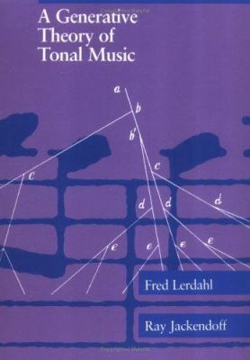
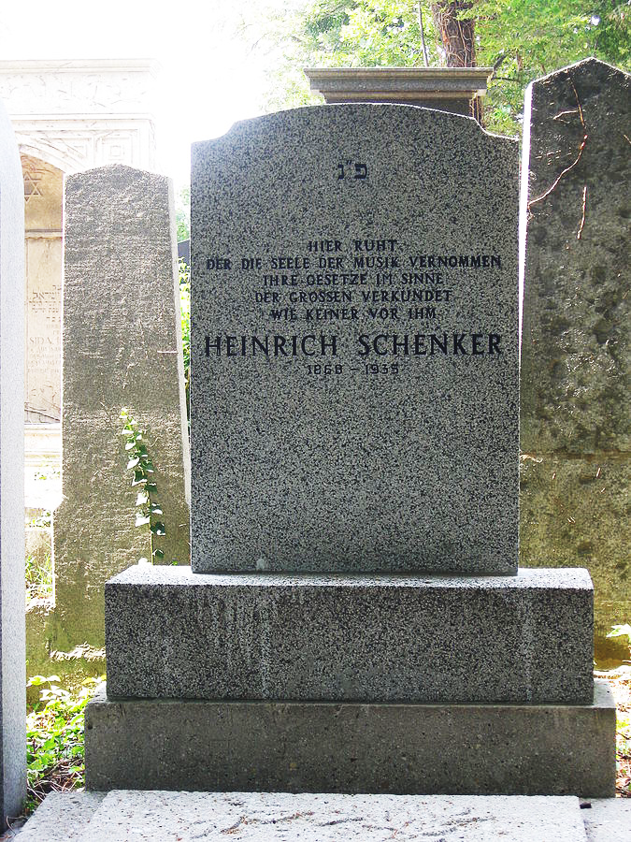
Generative Theories
4
Notes:
4

Slide 5
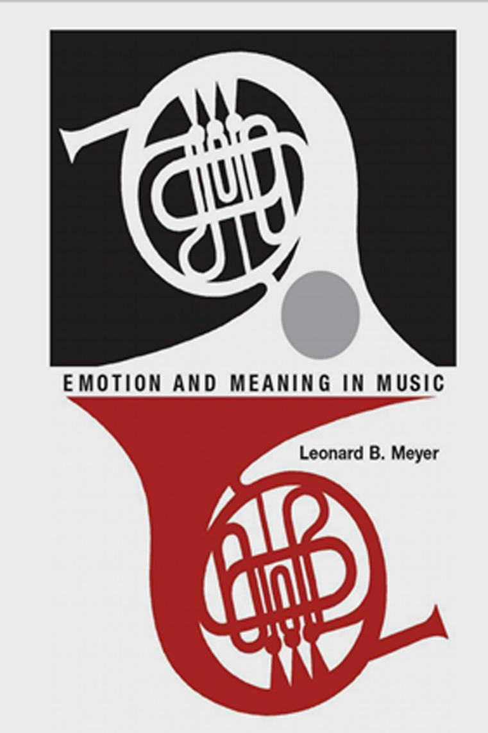
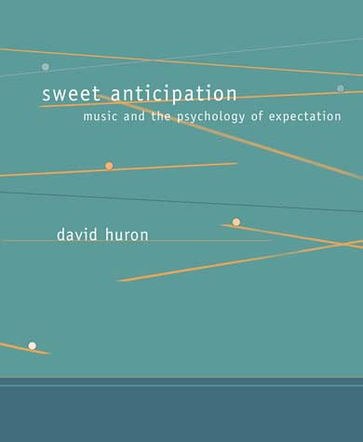
Expectation Based Theories
5
Notes:
5

Slide 6
Complementarity Between Description and Explanation
Good descriptive models are mostly not very explanatory (they use many ad hoc stipulations)
Good explanatory systems are normally based on many simplifications and often fail to give correct descriptions
Generative theories
explanation
description
Expectation based theories
explanation
description

Slide 7
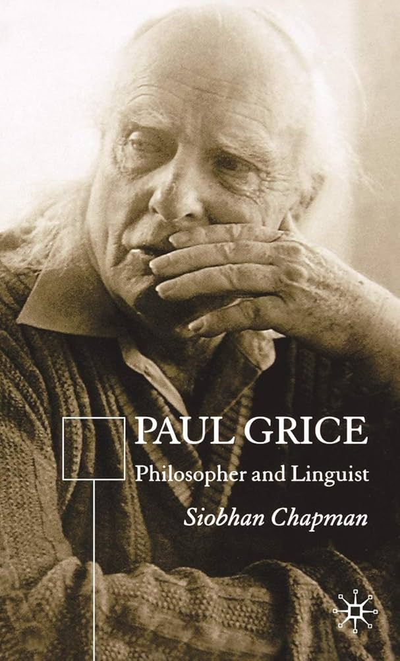
Paul Grice: Meaning (1954)
Grice has stated that the term “meaning” has different meanings. Importantly, he made the distinction between natural and nonnatural meaning
Natural Meaning (also called con-notation). Example: Smoke means fire. The connection between Fire and smoke is based on a natural connection
(fire causes smoke)
Nonnatural Meaning (also called referential meaning). Example: The German word “Hund” means dog.
Based on a convention.
7
Notes:
7

Slide 8
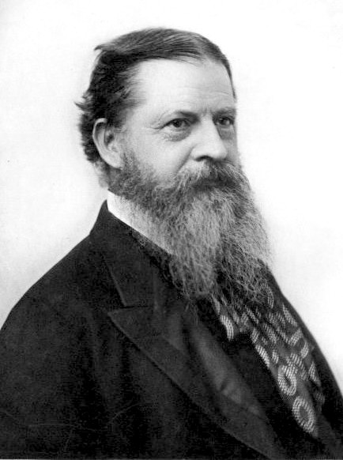

Charles Sanders Pearce: What is a sign? (1894)
Indexical: Smoke indicates fire
iconic: similarity between icon and what is signifies
Symbolic: The German word “Hund” is a symbol for the category of dogs
8
Notes:
8

Slide 9
II
Similarities and Differences between Music and Language
9
Notes:
9

Slide 10
Language and Music as Representational Systems
(referential) meaning
Language
  (referential) meaning
Music
affective meaning
connotation
code
lexicon
nonnatural meaning
no code
no lexicon
natural meaning
10
Notes:
10

Slide 11
Three Constituents of Music
Harmony
Melody
Rhythm
Harmony is missing in language. Speakers can have one voice only
Prosody 1: intonation (basically in terms of pitch
Prosody 2: metre (= basic rhythmic structure of a verse)
More differences
Discrete pitches in music; continuous pitches in language
Music and language express emotions in different ways. So (surprise) So (disapproval)
Language → conventional Music → natural
Isochronic metre in music, not necessarily in language

Slide 12
Preliminary Conclusion
Bierwisch: Music does not communicate feelings, but it can show them. (Communication: The listener is recognizing the relevant intentions of the speaker)
Important question: How does music trigger emotions?
Music is based on a discrete set of tones (why 12 tones?)
Harmony is the most important feature of music since about 500 years. It is an important trigger of emotions.

Slide 13
III
Music and its Affective Meaning
13
Notes:
13

Slide 14
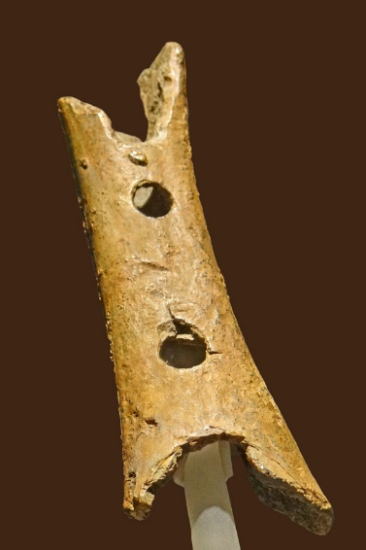

Why do we like music?
Bone flute (40.000 years old) found in the Neanderthal (associated with homo sapiens)
Music and the reward system:
  Dopamine release occurred in the
  striatum (prefrontal cortex) during
  the presentation of music
Bernstein’s Harvard lectures
  The capacity to understand and derive pleasure from complex musical patterns appears to be culturally universal

Slide 15
Doctrine of Affects
R. Descartes in his Compendium
of Music (1618): “The basis of music
is sound; its aim is to please and to
arouse various emotions in us.”
The doctrine can be seen as a Baroque practice that relates music with various emotions. The idea dates back to ancient Greece and the teachings of the temperaments
According to Descartes, the rhythm of music is intended to evoke such a mood in our soul which is similar to the mood expressed in music.
  slow rhythm → soft and weary feelings (dejection/sadness)
  fast rhythm → lively and cheerful feelings, such as joy.

Slide 16
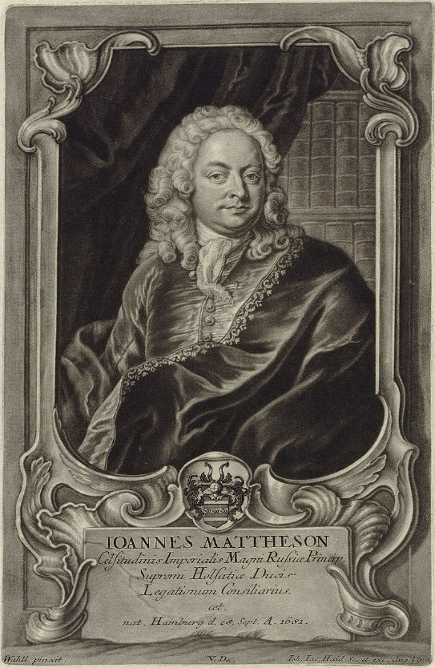
Doctrine of Affects: Example
Johann Mattheson (1681-1764) was a leading proponent of the Doctrine of Affects.
In his book Der vollkommene Capellmeister (1739), he proposed a thorough outline of melodic intervals and their affective purposes.
Mattheson’s understanding of intervals:
  major third → liveliness
  minor third → mourning/sadness
  fifth → boldness/confidence
  seventh → supplication/appeal

Slide 17
Problems with the Doctrine
Systematicity failure: A list of associations can describe the situation. However, it cannot explain it.
The myth of discrete emotions: Emotions are graded. I.e., we have an infinite set of emotions with a defined similarity metric.
Contextual puzzle: Depending on previous context, chords sound different. A strict mapping thesis cannot account for this observation.

Slide 18
Thoughts on Music and Emotion
Hanslick (1854): There is no real correspondence between a musical composition and the feelings it elicits.
Hindemith (1961): (i) Composers do not actually feel the emotions they strive to convey. (ii) Expectation is central to the aesthetic effects of music: we derive pleasure from having our expectations met.
Meyer (1956): Emotions are born of conflict and frustration. The emotional effect of music does not come from having our expectations met but from having them more or less thwarted.
Huron (2006): Justification of Meyer’s theory comes from evolutionary biology.

Slide 19
Meyer’s Smoking Example (1956)
For smokers, the availability/non-availability of cigarettes has a positive/negative value
  A man reaches into his pocket for a cigarette. But he has none. Then he discovers that there are none in the house, and sees that it is late and the shops are closed. This steady frustration of his desire creates first restlessness, then irritation and finally anger.
  Just then his friend knocks and on the door and turns out to have a packet of cigarettes in his coat. Anger and anxiety give rise to joy and relief.
For listeners of music consonance/dissonance has a positive/negative value
not e.
‒
exp
Neutral region
exp
+
not e.

Slide 20
Consonance/Dissonance
Fux’ classification of consonant (green) / dissonant (red)
Helmholtz (1877): Beat frequen-
cies around 30‐40 Hz are respons-
ible for dissonance perception
Stumpf (1890): Fusion, i.e. Consonant
intervals show a tendency to cohere
into a single sound gestalt (called unit)

Slide 21
Pleasure-arousal judgment space for affective feelings
Russell‘s circumplex theory of emotions
(based on two dimensions: Pleasure & Arousal

Slide 22
Two Roads to Affective Meaning
Consonant/dissonant events are expected to a certain degree. What is the emotional response of their realization?
Uncertainty
(Entropy)
Pleasure

Slide 23
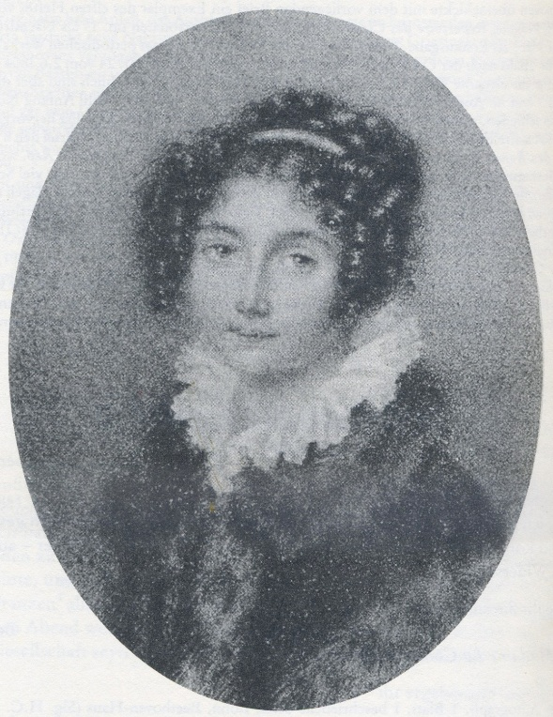

Sadness and Grief
„Sadness is an affective state characterized by low physiological arousal. When sad, a person typically exhibits slow heart rate, shallow respiration, slumped posture, loss of appetite, sleep, reduced engagement with the world, a tendency to avoid conversation (i. e., mute), and rumination (thinking sad thoughts). Grief, by contrast, is an affective state characterized by high physiological arousal. When in a state of grief, a person typically exhibits fast heart rate, erratic respiration, flushed face, tears, nasal congestion …“ (Huron, 2012, p. 476)
Chopin’s marche funébre of the B flat minor sonata Op. 35. Sadness
Beethoven’s Adagio of the
A flat minor sonata Op. 110. Grief
(in memory of his “immortal beloved”?)

Slide 24
Four types of affective feelings
Arousal
Exited joy,
enthusiasm
Grief
Pleasure
Sadness
Relaxed joy,
serenity
Chopin’s march: With each chord comes clear expectations of which chord will come next. (low arousal).
Beethoven’s Adagio: The opposite seems to be true
(high arousal).

Slide 25
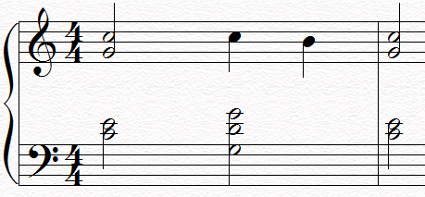
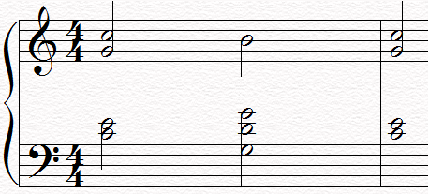
Example: Suspension Cadence
Route in the emotional space
  Fux (1725):
  “it is incredible
  how much grace the
  melody acquires by
  this means”
  (i.e., suspension)
25

Slide 26
IV
Tonal Attraction: Empirical Data and Idealizations
26
Notes:
26

Slide 27

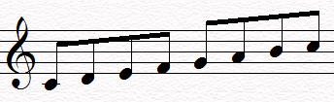
Three Empirical Questions
Consonance/Dissonance
  How well sounds a given interval of tones?
Static Attraction
  What tone fits best for a given scale?
Dynamic Attraction
  What is the best resolution of a chord (e.g. the Tristan Chord)?
Notes:
27

Slide 28
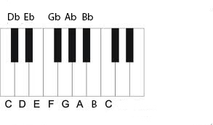
Static Attraction: The Experiment
12 pitch
classes (= tones)
Experiment
  Presentation of tonal context (scale or cadence)
  Presentation of target tone
  Judgment of static tonal attraction (how well does the target tone fit into the given context?)
1
3
6
8
10
0
2
4
5
7
9
11
0
Diatonic scale
Notes:
28

Slide 29

What makes empirical research succesful?
Simplification/Idealization: Assuming octave equivalence of tones and chords
The inversion triad: These three chords sound different. Ignore the differences
The trick is to use the so-called Octave tones (Shepard tones). They unify the chords and overcome the differences
Notes:
29

Slide 30
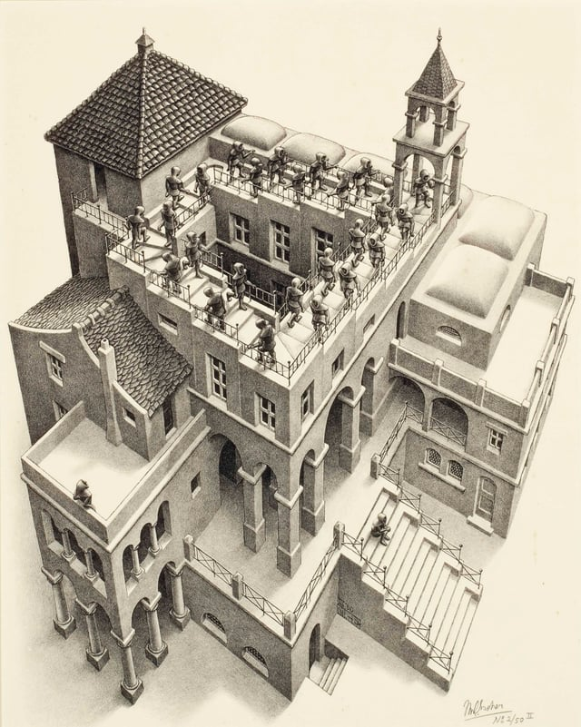
What makes empirical research succesful?
Shepard tones are constructed as superposition of sine waves separated by (weighted) octaves.
Auditory illusion of a tone that continually ascend (or descend in pitch)
Acoustic counterpart to the Escher-Penrose stairs
These tones produce a realiz-ation of octave equivalence
Notes:
30

Slide 31
Static Attraction: Results
C | C♯ | D | E♭ | E | F | F♯ | G | A♭ | A | B♭ | B
C | C♯ | D | E♭ | E | F | F♯ | G | A♭ | A | B♭ | B
major scale (∙ KK data ∙) minor scale
Observations
  the 7 tones of the (diatonic) scale have higher values of tonal attraction than the 5 tones which are not part of the scale
  tones of the tonic triad have higher values than the other tones of the scale
Notes:
31

Slide 32
Dynamic Attraction: The Experiments
Asking for most probable progressions of chord sequences
Asking for the most probable resolution of a chord
Using corpus data of musical progressions
→ There are simple descriptive rules for chord progression
Notes:
32

Slide 33


Chords
Given a major key, there are 7 chords connected with it (Schönberg 1911, 1954)
I ii iii IV V vi vii⁰
Key: C-major
  Major chords: I, IV, V
  Minor chords: ii, iii, vi
  Diminished chord: vii⁰
What are plausible chord progressions?
Notes:
33

Slide 34


Results: Rules for Chord Progression
Piston’s rules: “IV is followed by V, sometimes I or ii, less often iii or VI.”
Corpus data of a sample of baroque music (Huron 2006)
Most probable progressions
I → V → I
I → IV → V → I
40% 70%
30% 40% 70%
Notes:
34

Slide 35
Attractions and musical proporties
Such rules can give nice description of the situation
For explanations we look for systematic relations between the two attraction types and the empirical findings.
Next, I will make plausible
  how consonance/dissonance is connected with static attraction
  and how chord progression is connected with dynamic attraction
Notes:
35

Slide 36
Static Attraction and Consonance
Idea: Consonance is pleasure and dissonance is displeasure. It can be explained by certain configurations of static attraction
Static attraction: which tones fit best to a given chord? (representing the chord as a whole)
consonant
Consonant chords have a prominent fundament, but dissonant chords do not
dissonant
C
    E
G
G
D
B
36
Notes:
36

Slide 37
Dynamic Attraction and Arousal
Idea: Arousal is elicited by situations of uncertainty concerning the tonal dynamics
Dynamic attraction: which tone is expected to follow a given chord? (or: resolves a given chord)
Low arousal
High arousal is triggered by uncertain resolutions
High arousal
F
C
A
C
G
E
37
Notes:
37

Slide 38
V
A Geometric Model of
Tonal Attraction
Notes:
38

Slide 39
Computational Music Theory
Bayesian approaches
  e.g. David Templey, Music and Probability (MIT Press 2007).
  Music perception is largely probabilistic in nature
  Where do the probabilities come from?
Structural approaches
  E.g. Guerino Mazzola, The Topos of Music (Birkhauser 2002).
  Music perception (esp. perception of consonances/dissonances) based on certain symmetries
  Purely structuralist approach without probabilistic elements
The intended geometric theory combines both of these approaches

Slide 40
What have we achieved?
Static attraction → consonance/dissonance
Dynamic attraction → arousal dimension
What else do we need?
Systematic theory of static attraction
Related theory of dynamic attraction
What is the basis?
Formal representation of the 12 tones, based on certain symmetry principles
Notes:
40

Slide 41

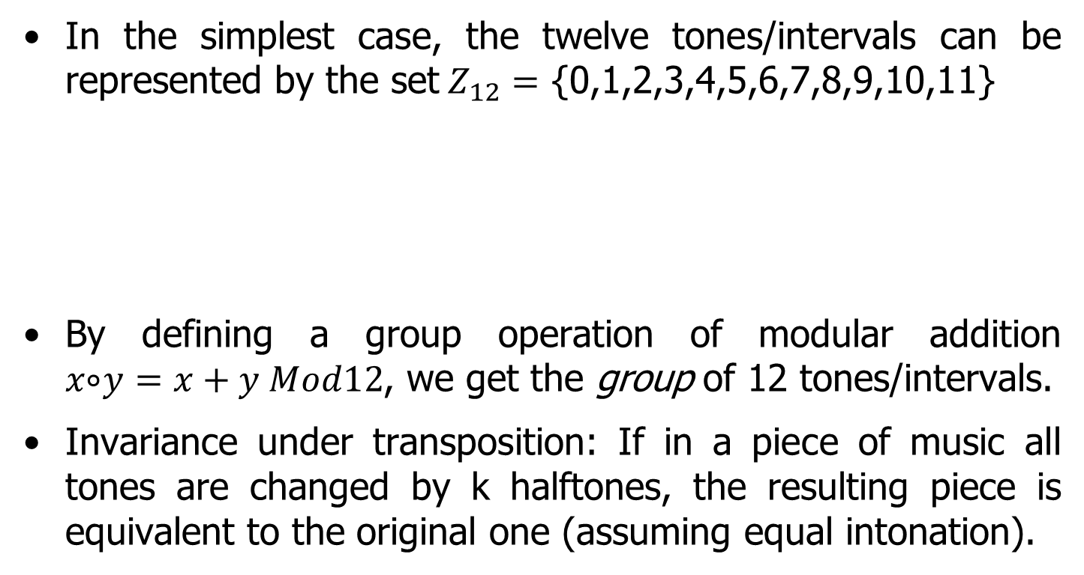
Symmetries and the 12 Tones
In the simplest case, the twelve tones/intervals can be represented by the set$Z_{12}=$ {0,1,2,3,4,5,6,7,8,9,10,11}
By defining a group operation of modular addition
$x ⃘y=x+y Mod12$, we get the group of 12 tones/intervals.
Invariance under transposition: If in a piece of music all tones are changed by k halftones, the resulting piece is equivalent to the original one (assuming equal intonation).
0 1 2 3 4 5 6 7 8 9 10 11
Notes:
41

Slide 42
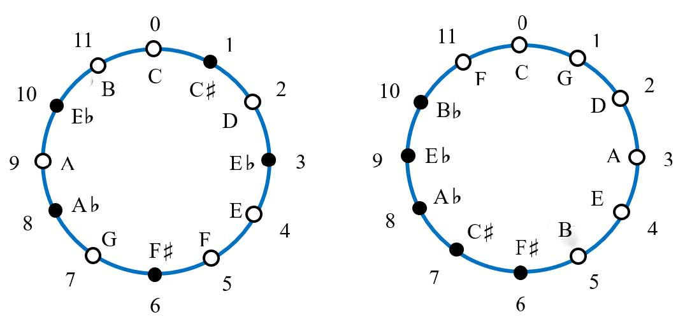
Two ways of representing the cyclic group
Chromatic circle Circle of fifth
There are exactly 2 generators of the group:
  x ±1 mod 12 (chromatic circle)
  x±7 mod 12 (circle of fifth)
Notes:
42

Slide 43
Why 12 tones? Bolzano’s (1980 group theoretic analysis))
There should be at least two generators of the whole group (→ base of static and dynamic attraction)
One generator defines connected tone scales (diatonic, pentatonic scales)
The group is the direct product of two subgroups
12= 3x4 (→ Tonnetz based on minor and major thirds)
The system with 12 tones satisfies the conditions. It is the smallest system satisfying the conditions. The subsequent systems are defined by n=4x5=20, n=5x6=30, n=6x7=42, …

Slide 44
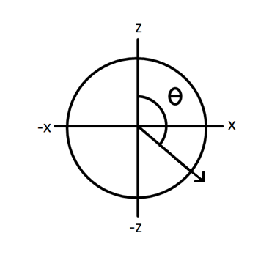
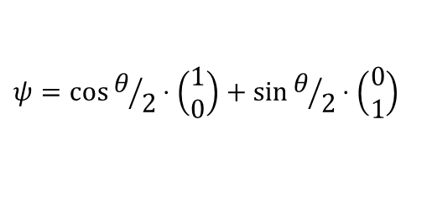
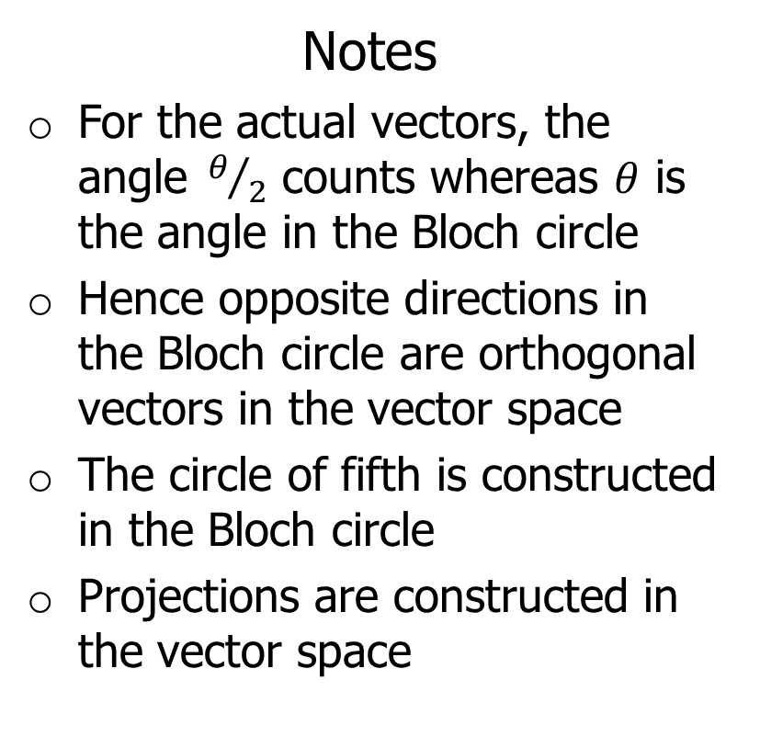
Vector representations and the Bloch circle
Real Hilbert Space:
Notes
For the actual vectors, the angle$θ/2$ counts whereas $θ$ is the angle in the Bloch circle
Hence opposite directions in the Bloch circle are orthogonal vectors in the vector space
The circle of fifth is constructed in the Bloch circle
Projections are constructed in the vector space
$$ψ=\cos{θ/2}⋅\left(\begin{matrix}1 \\ 0\end{matrix}\right)+\sin{θ/2}⋅\left(\begin{matrix}0 \\ 1\end{matrix}\right)$$
ψ

Slide 45
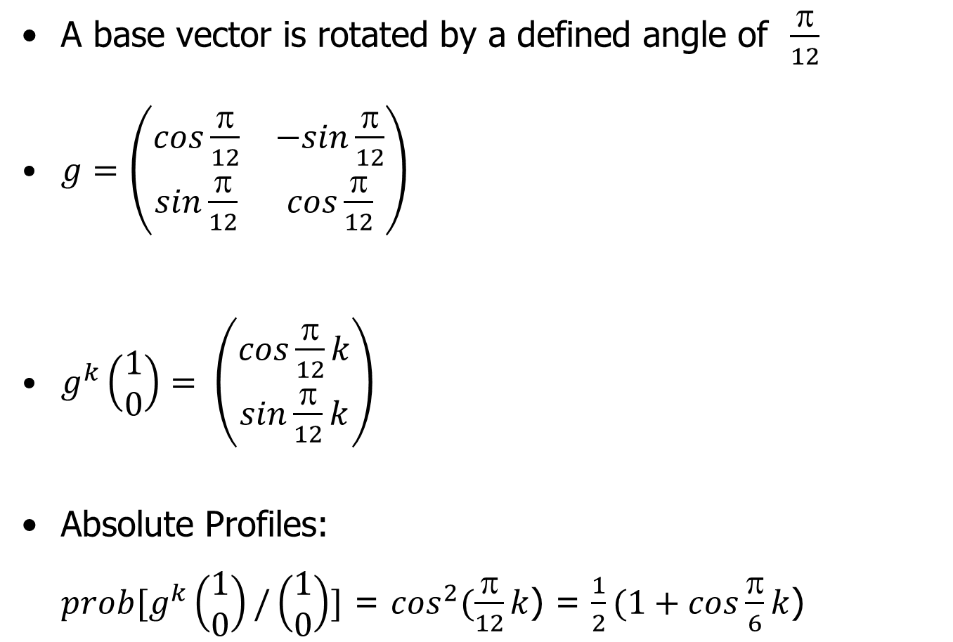



Representation Theory
A base vector is rotated by a defined angle of $\frac{π}{12}$
$g=\left(\begin{matrix}cos\frac{π}{12} & −sin\frac{π}{12} \\ sin\frac{π}{12} & cos\frac{π}{12}\end{matrix}\right)$
$g^{k}\left(\begin{matrix}1 \\ 0\end{matrix}\right)= \left(\begin{matrix}cos\frac{π}{12}k \\ sin\frac{π}{12}k\end{matrix}\right)$
Absolute Profiles:
$prob[g^{k}\left(\begin{matrix}1 \\ 0\end{matrix}\right)/\left(\begin{matrix}1 \\ 0\end{matrix}\right)]$ = $\cos^{2}(\frac{π}{12}k$) = $\frac{1}{2}(1+cos\frac{π}{6}k$)
$$g^{k}\left(\begin{matrix}1 \\ 0\end{matrix}\right)$$
$$\left(\begin{matrix}1 \\ 0\end{matrix}\right)$$
$$l^{2}= prob$$
Notes:
45

Slide 46



?
?
?
?
?
?
?
?
?
?
?
?
?
?
?
?
?
?
?
?
?
?
?
?
?
?
?
?
?
?
?
?
?
?
?
?
0
2
4
6
8
10
12
0.2
0.4
0.6
0.8
Major/minor keys
?
?
?
?
?
?
?
?
?
?
?
?
?
?
?
?
?
?
?
?
?
?
?
?
?
?
?
?
?
?
?
?
?
0
2
4
6
8
10
12
0.2
0.4
0.6
0.8
C | G | D | A | E | B | F♯ | C♯ | A♭ | E♭ | B♭ | F
Reinhard Blutner

Slide 47


Orthogonal Pitches
C | G | D | A | E | B | F♯ | C♯ | A♭ | E♭ | B♭ | F

Slide 48
Conclusions
The main difference between language and music is that in language, different voices follow each other, while in music they can act in parallel.
Cognitive models of music should integrate structural factors (based on symmetries) with factors of uncertainty (quantum probabilities).
The assignment of affective meaning in absolute tonal music is based on the integration of two main factors: musical uncertainty (arousal) and the consonance/dissonance dichotomy (pleasure).
Tonal attraction profiles and the consonance/dissonance distinction are not enough for a real understanding how the affective meaning of music is constructed. Tonal grouping, event hierarchies, rhythm, timbre, and micro-variations in timing and loudness are other important factors.
Notes:
48
48

