Slide 1



Some Thoughts about the Union of Thinking and Feeling
Dayalbagh Science of Consciousness
European leg on May 25, 2020
Christian Albrechts University, Kiel
Reinhard Blutner
Universiteit van Amsterdam

Slide 2

Three Theses
Efficient Human choice behavior demands gut feelings
The man who saved the world
  Three weeks after the Soviet
  military had shot down Korean
  Air Lines Flight 007 (in Sept 1983),
  the Russian nuclear early-warning
  system reported that a missile had
  been launched from the United States.
  Based on his gut feelings, colonel
  Petrov judged these reports as
  false alarms!
Stanislav Petrov
2
Notes:
2

Slide 3


The cognitive system of music affects our feelings
Why do we like music?
  Bone flute (40.000 years old) found in the
  Neanderthal (associated with homo sapiens)
  Robert Zatorre (music and the reward system):
  dopamine release occurred in the striatum
  (situated deep in the subcortex) during the
  presentation of music
  The capacity to understand and derive pleasure from complex
  musical patterns appears to be culturally universal (→ Bernstein’s Harvard lectures)
3
Notes:
3

Slide 4
Conscious feelings affects the allocation of cognitive resources
Is the term consciousness ambiguous?
  Access consciousness
  Phenomenal consciousness (qualia)
  Self-consciousness
  Spiritual consciousness
When a picture / piece of music “creates” conscious feelings then more resources are allocated to the emotional event
4
Notes:
4

Slide 5
Structuring
Efficient Human choice behavior demands feelings.
  Feelings → Thinking
  Blutner, R., & beim Graben, P. (2016). Quantum Cognition and Bounded Rationality. Synthese, 193(10), 3239-3291.
Musical expectation (thinking) is essential for the development of (aesthetic) feelings.
  Thinking → Feelings
The role of consciousness
  Emotions can be trigerred nonconsciously but they cannot continue without core consciousness (Damasio)
  Conscious feelings allocate resources to the emotional event
5
Notes:
5

Slide 6

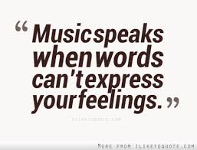
Music and Feelings
Music is the language of our feelings
The meaning of music are the
elicited/expressed feelings
6
Notes:
6

Slide 7
Language and Music as Representational Systems
(referential) meaning
Language
  (referential) meaning
Music
affective meaning
code
lexicon
non-natural meaning
connotation
no code
no lexicon
natural meaning
7
Notes:
7

Slide 8
Doctrine of Affects
R. Descartes in his Compendium of Music (1618): “The basis of music is sound; its aim is to please and to arouse various emotions in us.”
The doctrine can be seen as a Baroque practice that relates music with various emotions. The idea dates back to ancient Greece and the teachings of the temperaments
According to Descartes, the rhythm of music is intended to evoke such a mood in our soul which is similar to the mood expressed in music.
  slow rhythm → soft and weary feelings (dejection/sadness)
  fast rhythm → lively and cheerful feelings, such as joy.

Slide 9
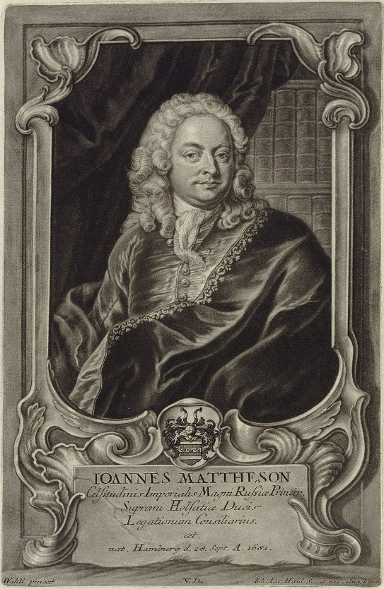
Doctrine of Affects: Example
Johann Mattheson (1681-1764) was a leading proponent of the Doctrine of Affects.
In his book Der vollkommene Capellmeister (1739), he proposed a thorough outline of melodic intervals and their affective purposes.
  Mattheson’s understanding of intervals:
    major third → liveliness
    minor third → mourning
    fifth → boldness
    seventh → supplication

Slide 10
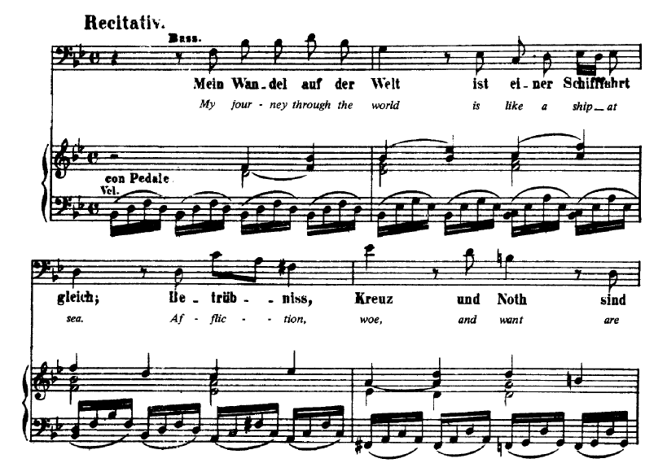

Bach's Cantata (BWV 56)
"I will the cross-staff gladly carry"

Slide 11
Comments
Kreuzstab (cross-staff )
= Jakobsstab (Jacob’s staff)
  Navigation instrument used
  before the invention of the
  sextant (positive connotation)
  Secondary interpretation: allegorical use of the term Kreuzstab referring to the suffering of Christ’s Passion
G. Corall: Opposed affects within one particular composition
  Positive emotions (joy, elation) in the first 2+½ measures
  Pain and sadness in the remaining measures
  Close correspondence between text and music. The musical intervals express emotional color, and reveal the intended affects.

Slide 12
My Problems with the Doctrine
Contextual puzzle: Depending on previous context, chords sound different. A strict mapping thesis cannot account for this observation.
Systematicity failure: A list of associations can describe the situation. However, it cannot explain it.
Failure of embodiment: The desribed sytem is purely symbolic and not embodied.
Limited expressibility: Not every emotion can be expressed by music. How to distinguish anger and fear in music?)
The myth of discrete emotions: Infinite set of emotions with a defined similarity metric.
12
Notes:
12

Slide 13
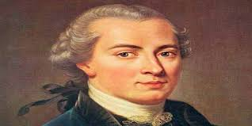
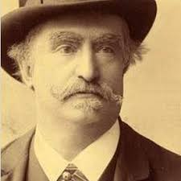
Kant and Hanslick
Kant: He developed the conception of aesthetic ideas: the conception of the beautiful as an interplay of sensuality and reason – connecting thinking and feeling.
Hanslick: The content of music is NOT the real feeling it elicits but the related aesthetic idea resulting from the the intrinsic dynamics of a piece of music.
  Definite feelings and emotions are unsusceptible of being embodied in music. … The physiological process by which the sensations of sound is converted into a feeling, a state of mind, is unexplained and will ever remain so. … Let us never appeal to a science for explanations which it cannot possibly give. (Hanslick, 1891)
13
Notes:
13

Slide 14
How feelings/emotions may arrise
Brain stem reflex
Rhytmic entrainment
Visual imagery
Evaluative conditioning
Musical Emotions
Episodic memory
…
Musical expectancy
Juslin & Sloboda 2013

Slide 15
Music, Feelings, Expectations
Hindemith (1961): (i) Expectation is central to the aesthetic effects of music: we derive pleasure from having our expectations met. (ii) Composers do not actually feel the emotions they strive to convey.
Meyer (1956): Emotions are born of conflict and frustration. The emotional effect of music does not come from having our expectations met but from having them more or less thwarted.
Huron (2006): Justification of Meyer’s theory comes from evolutionary biology.

Slide 16
Meyer’s Smoking Example (1956)
For smokers, the availability/non-availability of cigarettes has a positive/negative value
  A man reaches into his pocket for a cigarette. But he has none. Then he discovers that there are none in the house, and sees that it is late and the shops are closed. This steady frustration of his desire creates first restlessness, then irritation and finally anger.
  Just then his friend knocks and on the door and turns out to have a packet of cigarettes in his coat. Anger and anxiety give rise to joy and relief.
For listeners of music consonance/dissonance has a positive/negative value on a scale of valence
not e.
‒
exp
Neutral region
exp
+
not e.

Slide 17
Recent Experiment
Cheung, Vincent KM, et al.
29.23 (2019): 4084-4092.
In the experiment, subjects rated the pleasantness of chords and not their consonance/dissonance (harmony)
Notes:
17

Slide 18
Procedure
Presentation takes sequences from 745 popular pop songs (all transposed to C major). 30 chord progressions were formed each consisting of 30-38 chords.
Melody and rhythm were removed from the original songs – only the chord progressions were kept from the songs.
39 adults listened to 1,039 chords in the progressions.
They rated the pleasantness of each chord using a mechanical slider (not pleasant … very pleasant).
No subjects mentioned that the chord progressions in the stimuli were familiar to them.

Slide 19






Results 1
Rule: High uncertainty leads listeners to enjoy something conventional, whereas low uncertainty leads listeners to enjoy something novel (Huron 2019)
Table: Illustration of possible combinations of uncertainty and surprisingness for possible chord progressions
Implicative context
Consequent event
[low surprise]
[low uncertainty]
[high surprise]
[high surprise]
[high uncertainty]
[low surprise]

Slide 20
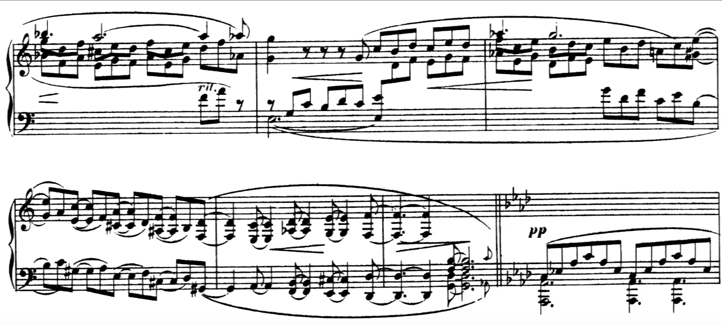
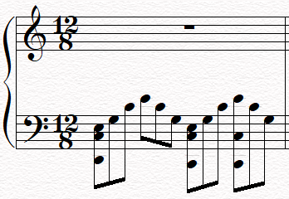
Realistic Example
Robert Schumann Fantasia C major, Op 17 (last part)

Slide 21
Results 2
Uncertainty and surprise as key
factors making music enjoyable
  predictive contexts (=low uncertainty)
  lead listeners to enjoy something novel
  non-predictive contexts (=high uncertainty)
  lead listeners to enjoy something conventional
The neural base of pleasure: a functional magnetic resonance imaging (fMRIi) study
  the interaction between uncertainty and surprise significantly modulated the BOLD (blood-oxygen-level-dependent) response in the bilateral amygdala and hippocampus

Slide 22
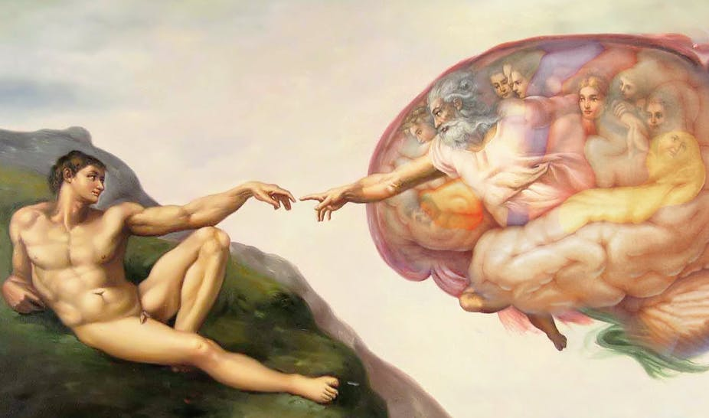
The Role of Consciousness
22
Notes:
22

Slide 23
What “Consciousness” Means
Consciousness as attentiveness including the ability to differentiate whether the object of cognition is internal or external. Access Consciousness
Consciousness as raw experience realizing our Qualia. Phenomenal Consciousness
Consciousness as mechanism for constructing our Self. Self-Consciousness
Spiritual Consciousness, connoting the relationship between the mind and God and including the experience of meditation
Stream of consciousness, altered states of conscious-ness, animal consciousness, …

Slide 24
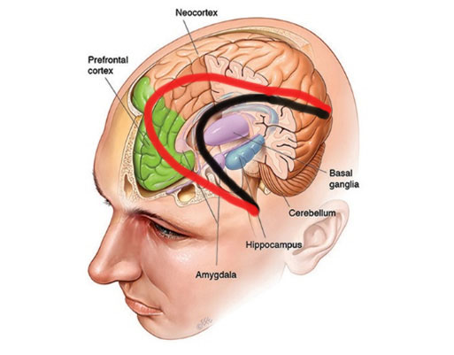
Emotions, Feelings, and Neural Circuits
Emotions can be trigerred nonconsciously but they cannot continue without core consciousness (Damasio)
Circuit of emotions:
Feedforward net:
Stimulus → thalamus → amygdala
→ hypothalamus → brains stem
Circuit of feelings:
Feedforward net:
Stimulus → thalamus → neocortex →
→ prefrontal cortex → brains stem
+ Recurrent net connecting areas of the visual cortex (cf. Crick & Koch, Lamme)

Slide 25
Intermezzo: Visual Awareness
+
Visual crowding
A normally visible figure may be unrecognizable when flanked by other, nearby stimuli (Cavanagh 2001)
+
When viewed in the peripheral visual field (fixation on the cross), the diagonal grating is visible on its own but is unrecognizable when surrounded by neighboring gratings.
The phenomenon should be treated within a general theory of resource limitation of conscious experience

Slide 26
Conscious Feelings
+
Conscious feelings allocate resources to the emotional event (Meinhardt and Pekrun 2003)
+
Evidence by a paradigm of divided attention: Simultanuos processing of emotional events (pictures) and recognition of pitch signals (secondary task).
P3 amplitude (in ERP) declines during the processing of pitch signals. This indicates that resources are allocated to the primary task (processing of pictures).

Slide 27
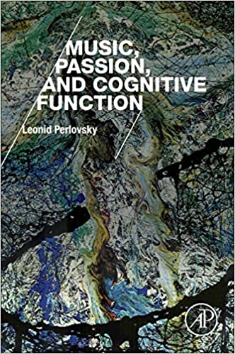
An Argument from Phylogenetics
Conscious feelings and music can help to overcome cognitive dissonances and to unify the inner world.
This may be an phylogenetic argument for the parallel evolution of consciousness, musical styles, and continued cultural development.

Slide 28
Summary
Descartes' error is the strict separation of thinking and feeling
  Efficient Human choice behavior demands gut feelings.
  Musical expectation (thinking) is essential for the development of (aesthetic) feelings.
The role of consciousness
  Conscious feelings allocate resources to the emotional event
  Emotions can be trigerred nonconsciously but they cannot continue without core consciousness
  Evolutionary advantage of emotional music: overcoming cognitive dissonances
Big Problems
  Embodied perspective: mind and body as two aspects of one unit. Integration of Eastern and Western thinking.
  Novel theoretical approaches to consciousness (Lamme)
Notes:
28
"the Brahman, as conceived in the Upanishads and defined by Sankara, is clearly the same as Spinoza's 'Substantia'." (Max Muller 2003)
28

Slide 29
Abstract
Some thoughts about the union of thinking and feeling
In classical, Cartesian theories of thinking and theories of feelings, both domains are strictly separated. For instance, early models of thinking and deciding are based on general ideas of rationality as developed in logic, probability theory and decision theory. Researchers of cognitive science have borrowed the idea of rational decisions from mathematical economics and game theory. The classical idea is to assume that rational agents are expected utility maximizers. Of course, emotions and feelings do not play any role in these Cartesian models. Early models of feelings, in contrast, are derived from ancient theories of rhetoric (Plato’s art of persuasion). It is described by a system of fixed rules. In music, this system associates certain musical forms with distinct affects and feelings (doctrine of affections). Essentially, processes of thinking are excluded in this approach.
In the first part of my talk I will outline some puzzles that illustrate the failure of theories that assume a strict separation of thinking and feeling. This concerns the nature of decision processes when considering the domain of thinking and ignoring the influence of emotions. On the other hand, in the domain of music, it concerns the emergence of musical meaning ignoring the role of thinking for the generation of aesthetic feelings. In the second part, I outline the role of consciousness for the integration of thinking and feeling into a unified, coherent system.

Slide 30
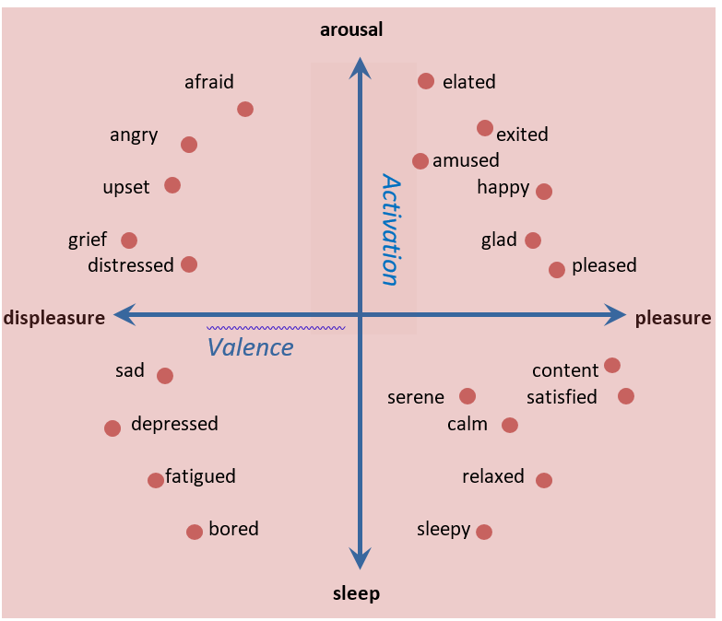
An affective Appraisal model
Russell (1961): arousal-valence model of emotions
For each chord, a dynamic attraction potential DAP can be calculated (probabilities of which tone comes next?)
Arousal ≈ entropy of the DAP
Valence ≈ based on consonance/dissonance. The percepted values are increased/reduced conforming to the degree of expectation
(cognitive versus perceptual consonance/dissonance).

